Slide 1
AWS Deployment tools
(SAM, Code Pipeline)
AWS Certified Solutions Architect– Professional (SAP-C01)
Study notes - Sep’2019

Slide 2
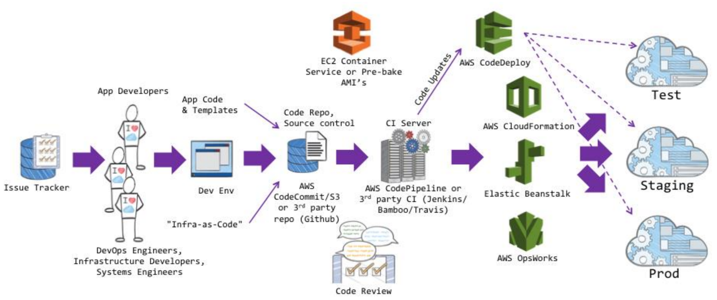
Overview of Deployment services

Slide 3
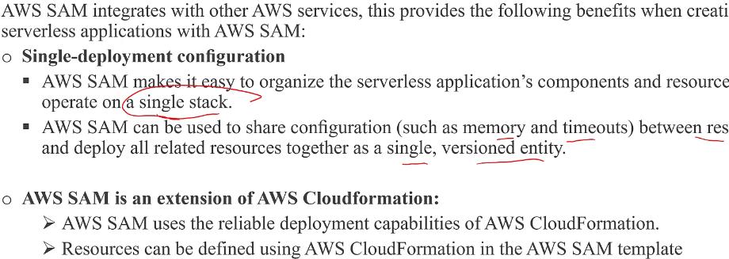
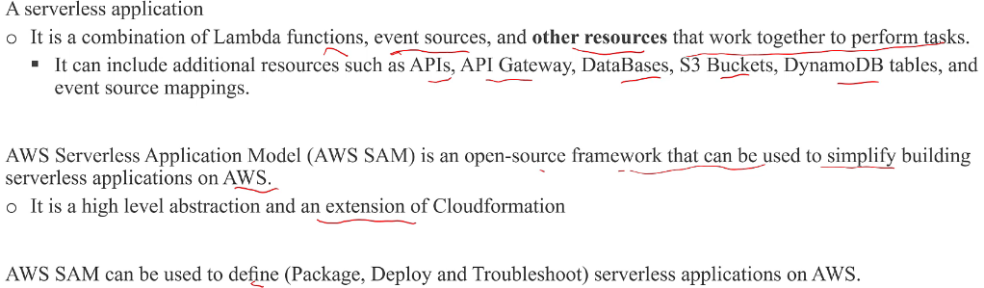
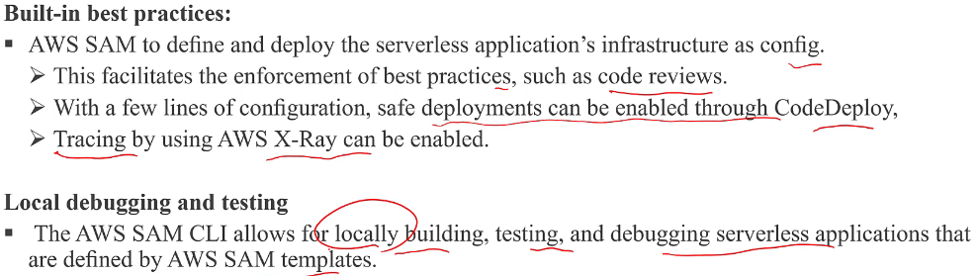
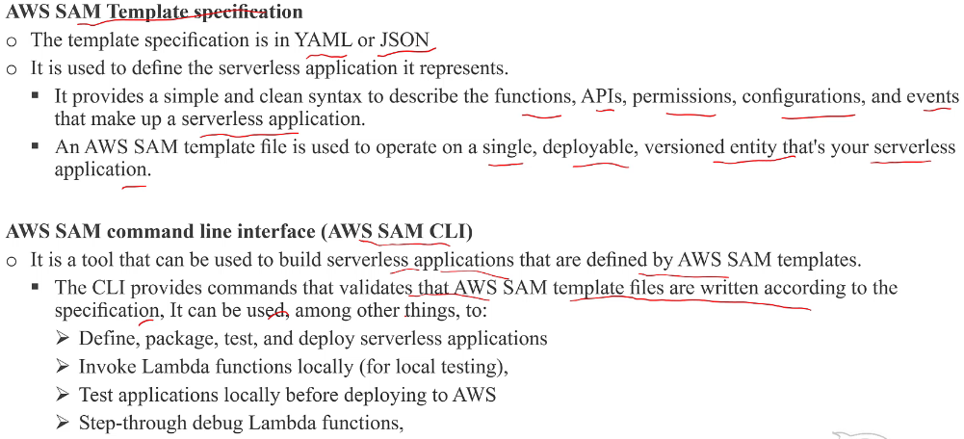
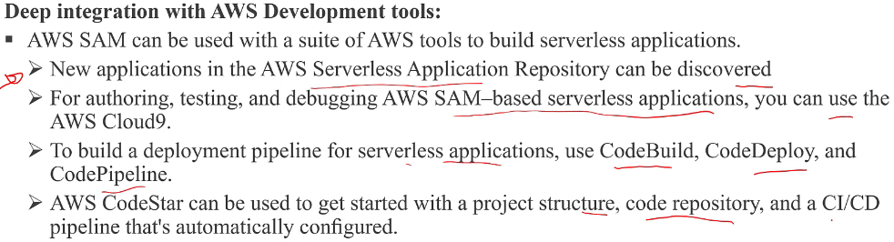
Serverless Application Model (SAM)
https://github.com/awslabs/serverless-application-model

Slide 4
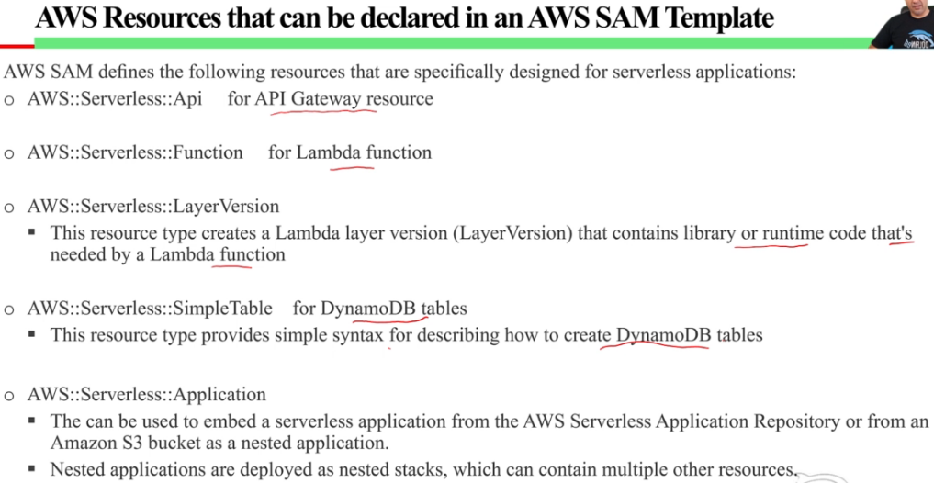
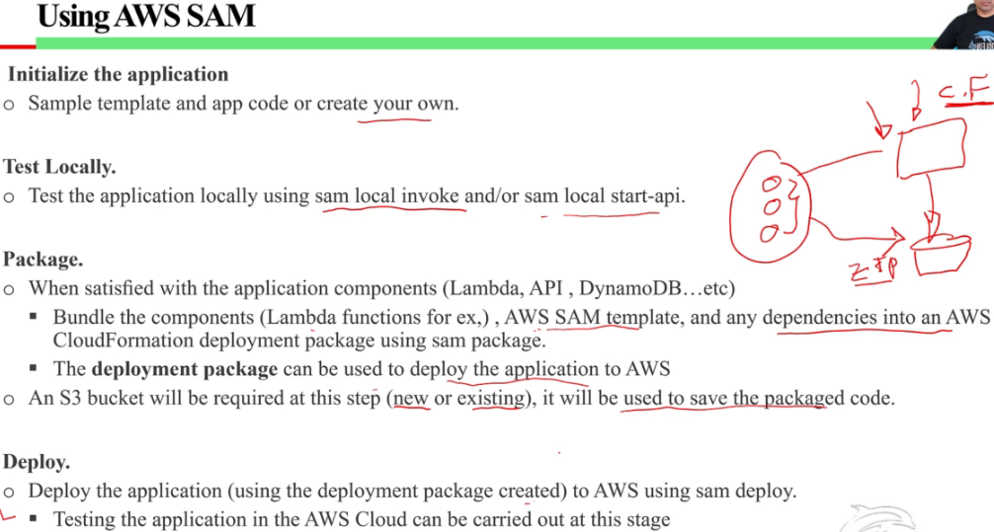
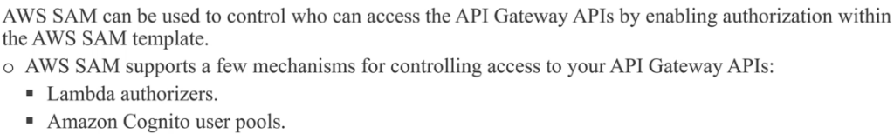
Serverless Application Model (SAM)

Slide 5
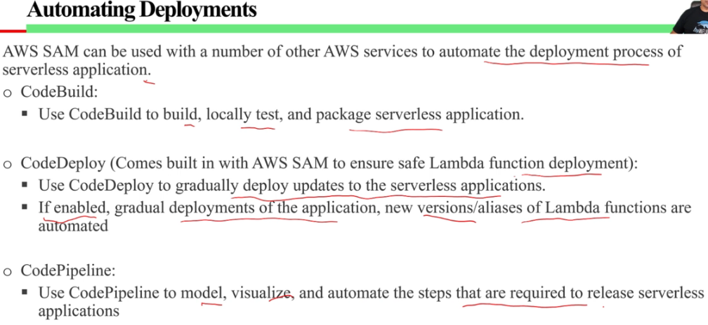
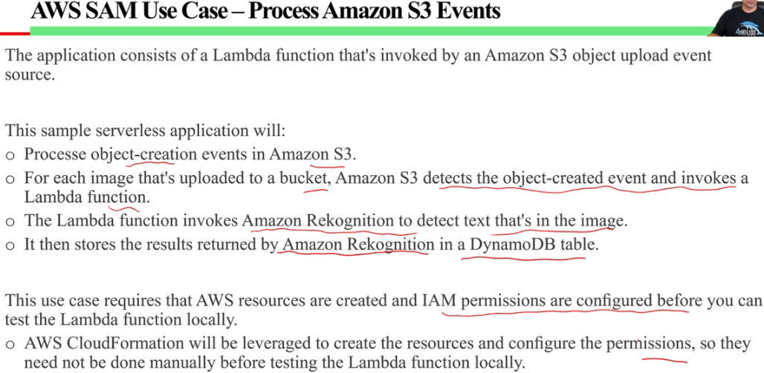
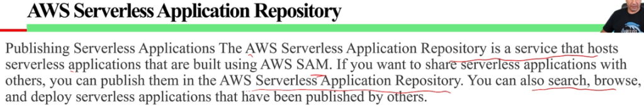
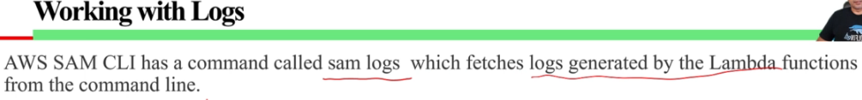
Serverless Application Model (SAM)

Slide 6

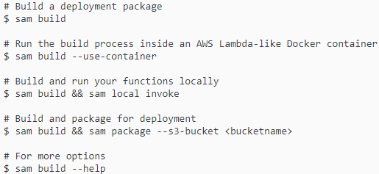
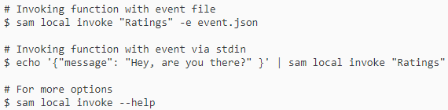
Serverless Application Model (SAM)
Building Applications with Dependencies
Generating sample event payload
Working with logs
sam logs -n HelloWorldFunction --stack-name mystack
sam logs -n mystack-HelloWorldFunction-1FJ8PD
sam logs -n HelloWorldFunction --stack-name mystack --tail
sam logs -n HelloWorldFunction --stack-name mystack -s '10min ago' -e '2min ago'
sam logs -n HelloWorldFunction --stack-name mystack --filter "error"
Invoking functions locally
Run Api gateway locally

Slide 7
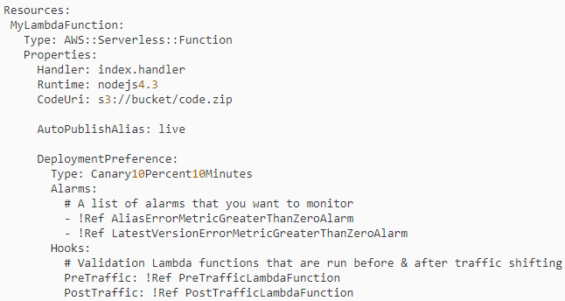
SAM - Gradual Code deployment
https://docs.aws.amazon.com/serverless-application-model/latest/developerguide/automating-updates-to-serverless-apps.html
https://github.com/awslabs/serverless-application-model/blob/master/docs/safe_lambda_deployments.rst
If you use AWS SAM to create your serverless application, it comes built-in with CodeDeploy to help ensure safe Lambda deployments. With just a few lines of configuration, AWS SAM does the following for you:
Deploys new versions of your Lambda function, and automatically creates aliases that point to the new version.
Gradually shifts customer traffic to the new version until you're satisfied that it's working as expected, or you roll back the update.
Defines pre-traffic and post-traffic test functions to verify that the newly deployed code is configured correctly and your application operates as expected.
Rolls back the deployment if CloudWatch alarms are triggered.
AutoPublishAlias:
Detects when new code is being deployed, based on changes to the function's S3 URI.
Creates and publishes an updated version of that function with the latest code.
Creates an alias with a name that you provide (unless an alias already exists), and points to the updated version of the Lambda function.
Deployment Preference Type:
Canary: Traffic is shifted in two increments.
Linear: Traffic is shifted in equal increments with an equal number of minutes between each increment.
All-at-once: All traffic is shifted from the original Lambda function to the updated Lambda function version at once.
Alarms: CloudWatch alarms that are triggered by any errors raised by the deployment. They automatically roll back your deployment.
Hooks: These are pre-traffic and post-traffic test functions that run sanity checks before traffic shifting starts to the new version, and after traffic shifting completes.

Slide 8
Code Deploy
Deployment Configurations on an EC2/On-Premises Compute Platform
Deployment Configurations on an Amazon ECS Compute Platform
CodeDeployDefault.ECSAllAtOnce - Shifts all traffic to the updated Amazon ECS container at once.
Deployment Configurations on an AWS Lambda Compute Platform:
Canary: Traffic is shifted in two increments. You can choose from predefined canary options that specify the percentage of traffic shifted to your updated Lambda function version in the first increment and the interval, in minutes, before the remaining traffic is shifted in the second increment.
Linear: Traffic is shifted in equal increments with an equal number of minutes between each increment. You can choose from predefined linear options that specify the percentage of traffic shifted in each increment and the number of minutes between each increment.
All-at-once: All traffic is shifted from the original Lambda function to the updated Lambda function version all at once.
Deployment Configuration | Description
CodeDeployDefault.AllAtOnce
CodeDeployDefault.HalfAtATime
CodeDeployDefault.OneAtAtTime
Deployment Configuration | Description
CodeDeployDefault.LambdaCanary10Percent5Minutes | Shifts 10 percent of traffic in the first increment. The remaining 90 percent is deployed five minutes later.
CodeDeployDefault.LambdaCanary10Percent10Minutes | Shifts 10 percent of traffic in the first increment. The remaining 90 percent is deployed 10 minutes later.
CodeDeployDefault.LambdaCanary10Percent15Minutes | Shifts 10 percent of traffic in the first increment. The remaining 90 percent is deployed 15 minutes later.
CodeDeployDefault.LambdaCanary10Percent30Minutes | Shifts 10 percent of traffic in the first increment. The remaining 90 percent is deployed 30 minutes later.
CodeDeployDefault.LambdaLinear10PercentEvery1Minute | Shifts 10 percent of traffic every minute until all traffic is shifted.
CodeDeployDefault.LambdaLinear10PercentEvery2Minutes | Shifts 10 percent of traffic every two minutes until all traffic is shifted.
CodeDeployDefault.LambdaLinear10PercentEvery3Minutes | Shifts 10 percent of traffic every three minutes until all traffic is shifted.
CodeDeployDefault.LambdaLinear10PercentEvery10Minutes | Shifts 10 percent of traffic every 10 minutes until all traffic is shifted.
CodeDeployDefault.LambdaAllAtOnce | Shifts all traffic to the updated Lambda functions at once.

